Slide 1
Longitudinal Motion
Eric Prebys, FNAL

Slide 2
Acceleration in Periodic Structures
We consider motion of particles either through a linear structure or in a circular ring
Always negative
In both cases, we can adjust the RF phases such that a particle of nominal energy arrives at the the same point in the cycle φ_{s}
Goes from negative to positive at transition

Slide 3
Slip Factors and Phase Stability
The sign of the slip factor determines the stable region on the RF curve.
η<0 (linacs and below transition)
η>0 (above transition)
“bunch”
Particles with lower E arrive earlier and see greater V.
Particles with lower E arrive later and see greater V.
Nominal Energy
Nominal Energy

Slide 4
Longitudinal Acceleration
Consider a particle circulating around a ring, which passes through a resonant accelerating structure each turn
The energy gain that a particle of the nominal energy experiences each turn is given by
where this phase will be the same for a particle on each turn
A particle with a different energy will have a different phase, which will evolve each turn as
Harmonic number (number of RF cycles per period)
Period of nominal energy particle
Synchronous phase
Phase difference from one turn to the next

Slide 5
Phase Difference
The phase difference can be expressed as
“synchronous” (nominal) energy

Slide 6
Longitudinal Equation of Motion
Thus the change in energy for this particle for this particle will evolve as
So we can write
Constant (or very slowly varying)
exact

Slide 7
Synchrotron Motion and Synchrotron Tune
Rewrite this equation as:
For small oscillations,
And we have
This is the equation of a harmonic oscillator with
Angular frequency wrt turn (not time)
“synchrotron tune” = number of oscillations per turn (usually <<1)

Slide 8
Longitudinal Phase Space and Emittance
We want to write things in terms of time and energy. We have can write the longitudinal equations of motion as
Following our procedure for longitudinal motion, we want to write this in form:
Taking the derivative wrt n and substituting for ΔE gives us

Slide 9
So we can write
Wait! We’ve seen this before. This looks just like our equation for longitudinal motion, but with α=0, so we immediately write
Where
Units: s/eV
Units: eV/s

Slide 10
We can define an invariant of the motion as
What about the behavior of Δt and ΔE separately?
Note that for linacs or well-below transition
Area=πε_{L}
units generally eV-s
Aspect ratio

Slide 11
Large Amplitude Motion
We have solved for the synchrotron tune in the limit of small oscillations, but in general we will not restrict ourselves to small oscillations.
Recall our exact equations of motion:
Multiply both sides by and integrate over dn
substitute
constant
exact

Slide 12
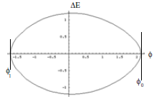
After a lot of messy (and not very intuitive) math, this becomes…
The curve will cross the φ axis when ΔE=0, which happens at two points defined by
Phase trajectories are possible up to a maximum value of φ₀. Consider .
Limit is at maximum of
unbound
bound

Slide 13
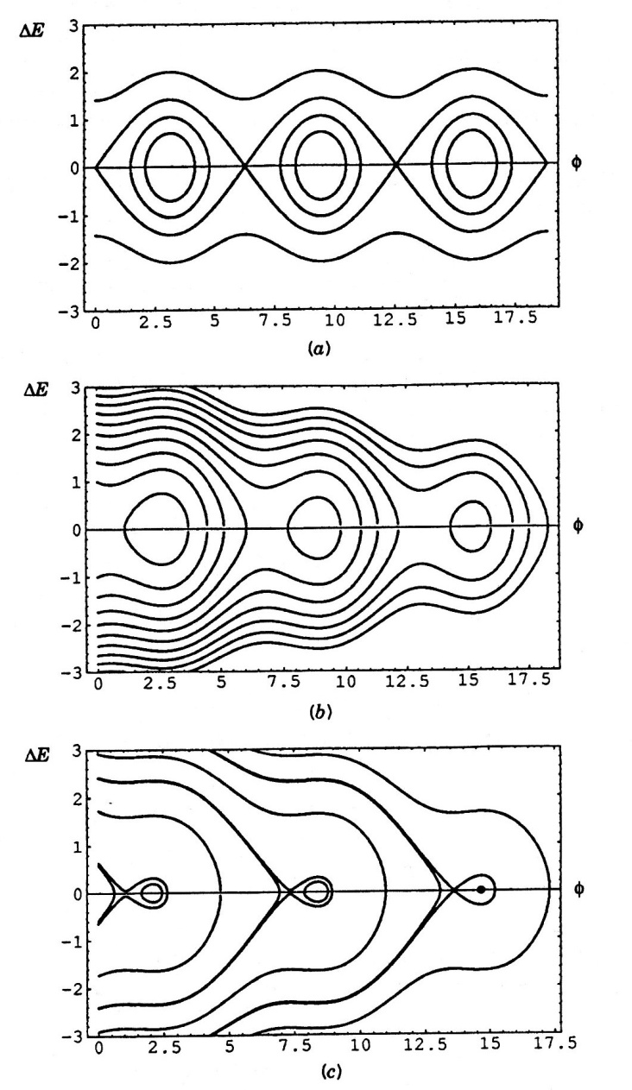
Longitudinal Separatrix
The other bound of motion can be found by
The limiting boundary (separatrix) is defined by
The maximum energy of the “bucket” can be found by setting φ=φ_{s}

Slide 14
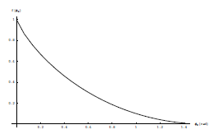
Bucket Area
The bucket area can be found by integrating over the area inside the separatrix (which I won’t do)

Slide 15
Transition Crossing
We learned that for a simple FODO lattice so electron machines are always above transition.
Proton machines are often designed to accelerate through transition.
As we go through transition
Recall so these both go to zero at transition.
To keep motion stable
At transition:

Slide 16
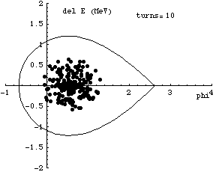
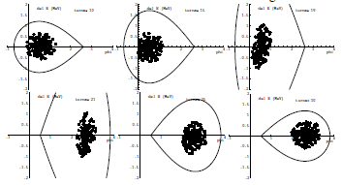

Effects at Transition
As the beam goes through transition, the stable phase must change
Problems at transition (pretty thorough treatment in S&E 2.2.3)
Beam loss at high dispersion points
Emittance growth due to non-linear effects
Increased sensitivity to instablities
Complicated RF manipulations near transition
Much harder before digital electronics

Slide 17
RF Manipulations
As you’ll show in homework, the synchrotron tune (longitudinal oscillations/turn) is generally <<1.
That means that if there are multiple RF cavities around the ring, the orbiting particle will see the vector sum of the cavities.
We will clearly get the maximum energy gain if all phases are the same, so (assuming all voltages are the same)
RF1
RF2
RF3
RF3
φ_{i} is the phase angle at the arrival of the particle at cavity i

Slide 18
Do we always want the maximum acceleration?
As we’ll see, there are times when we want to change the amplitude of the RF quickly.
Because cavities represent stored energy, changing their amplitude quickly can be difficult.
Much quicker to change phase
Standard technique is to divide RF cavities into two groups and adjust the relative phase. In the simplest case, we put half the RF cavities into group “A” and half into group “B”. We can adjust the phases of these cavities relative to our nominal synchronous phase as
So
Like “turning RF off”

Slide 19

Adiabatic Capture
We initially capture the beam by raising the RF voltage “adiabatically” (over many synchrotron oscillations). This insures that the longitudinal phase space stays matched to the RF bucket
If instead we simply turn the RF on, the beam will “filament”.
(simulations: IOTA ring, protons, K=2.5 MeV, τ=1.77 μsec, h=4, V_{max}=1kV)
dp/p
z [m]
z [m]
dp/p
z [m]
z [m]

Slide 20
Capture and Acceleration
We can adiabatically capture beam by increasing the RF voltage with no accelerating phase
As we accelerate beam, Δt decreases. Recall
So as beam accelerates, bunches get narrower

Slide 21
Bucket to Bucket Transfer
In general, the accelerating gradient of an RF structure is
So when bunches get short enough, it’s advantageous to transfer to a higher frequency. For example, in the Fermilab Linac
200 MHz Linac
800 MHz Linac
Transfer beam to every 4th bucket

Slide 22
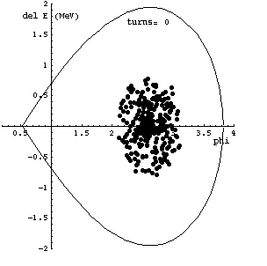
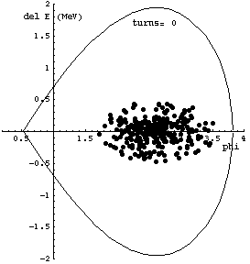
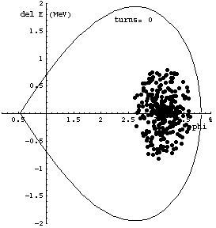



Bucket Transfers: Phase and Beta Matching
When we transfer beam from one machine to another, or from a lower frequency section to a higher frequency section, it’s important to correctly match the phases!
Matched transfer
β_{L} mismatch
Phase mismatch

Slide 23
Bunch Rotation
If we slowly change the RF voltage (or effective voltage by phasing), we can adiabatically change the bunch shape
If we suddenly change the voltage, then the bunch will be mismatched and will rotate in longitudinal phase space

Slide 24
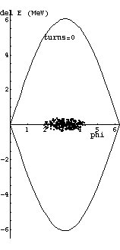

Bunch Rotation (cont’d)
Of course, non-adiabatically increasing the RF voltage (“snapping”) will cause the beam to filament, but the effect is minor over ¼ of a synchrotron oscillation

Slide 25
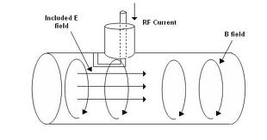
Accelerating Structures
The basic resonant structure is the “pillbox”
In cylindrical coords, Maxwell’s Equations Become:
Boundary Conditions:
Differentiating the first by δt and the second by δr:

Slide 26
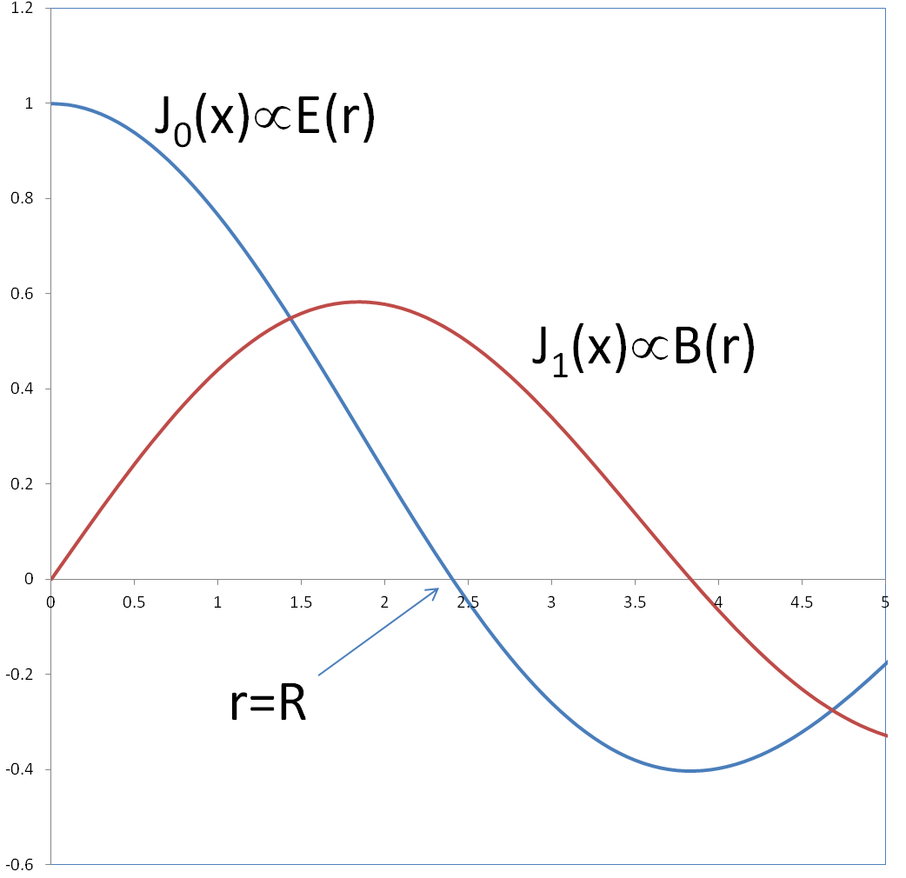
General solution of the form
Which gives us the equation
0th order Bessel’s Equation
0th order Bessel function
First zero at J(2.405), so lowest mode

Slide 27
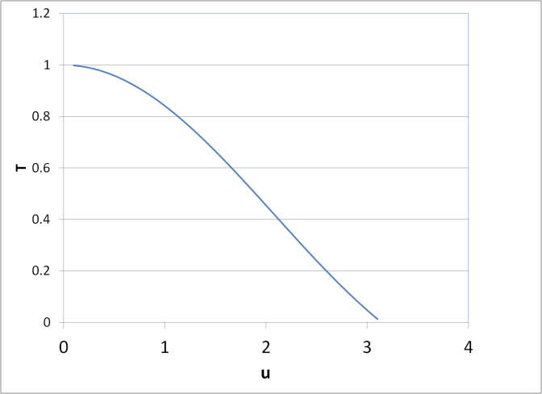
Transit Factor
In the lowest pillbox mode, the field is uniform along the length (v_{p}=∞), so it will be changing with time as the particle is transiting, thus a very long pillbox would have no net acceleration at all. We calculate a “transit factor”
Assume peak in middle
Example:
5 MeV Protons (v~.1c)
f=200MHz
T=85%➔u~1
Sounds kind of short, but is that an issue?

Slide 28
Power dissipation in RF Cavities
Volume=LπR²
Energy stored in cavity
Power loss:
=(.52)²~25%
Magnetic field at boundary
Surface current density J [A/m]
…………………….
B
Cylinder surface
2 ends
Average power loss per unit area is
Average over cycle

Slide 29
The figure of merit for cavities is the Q, where
So Q not very good for short, fat cavities!

Slide 30
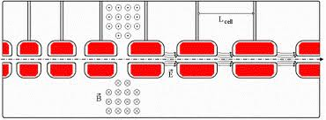
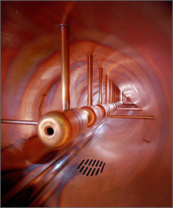
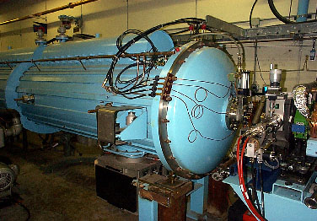
Drift Tube (Alvarez) Cavity
Put conducting tubes in a larger pillbox, such that inside the tubes E=0
Bunch of pillboxes
Gap spacing changes as velocity increases
Drift tubes contain quadrupoles to keep beam focused
➔
Fermilab low energy linac
Inside

Slide 31
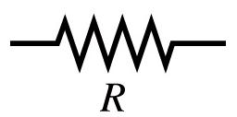
Shunt Impedance
If we think of a cavity as resistor in an electric circuit, then
By analogy, we define the “shunt impedance” for a cavity as
We want R_{s} to be as large as possible

Slide 32
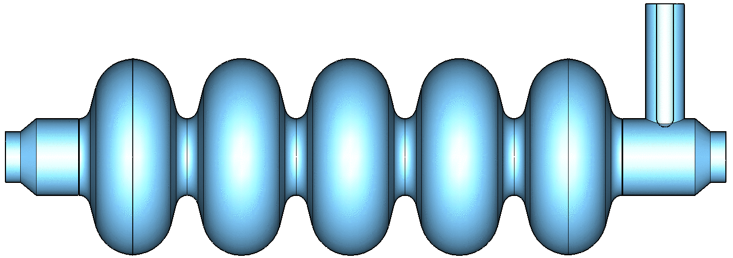
Other Types of Accelerating Structures
π cavities
These are phased so the particles always see acceleration.
Not practical when particle velocity is changing quickly
For higher energy particles, p cavities are “beta-matched” by section.

Slide 33
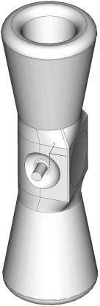
RF Cavities (cont’d)
Half-Wave Resonators and Spoke Resonators are optimized for low-β acceleration.
(Triple) Spoke Resonator
Half-wave Resonator

Slide 34
Example: Proposed PIP-II Front End
PIP-II is the linac which is proposed to replace the existing Fermilab Linac
Low Energy Beam Transport
RF Quadrupole (accelerate and bunch)
Medium Energy Beam Transport (MEBT)
Half Wave Resonators
Spoke Resonators
π cavities

Slide 35
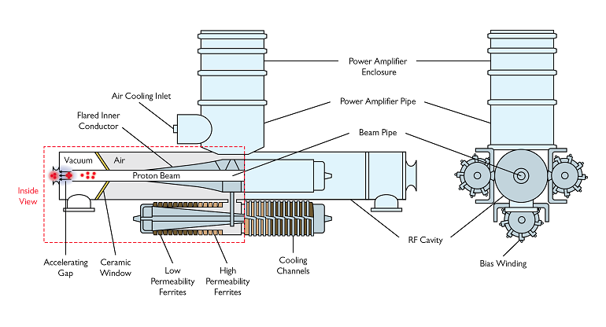
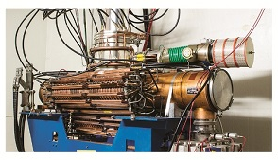
RF Cavities in Rings
RF Cavities in rings typically do not have to have high accelerating gradients, but they may have other challenges, particularly at low energy.
Example: Fermilab Booster cavities must change resonant frequency from 37 to 53 MHz, as the beam goes from 400 MeV to 8 GeV
Biased ferrite “tuners” use magnetic fields to load ferrite into its saturation region and thereby change its inducance.

Slide 36
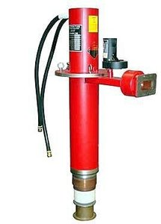
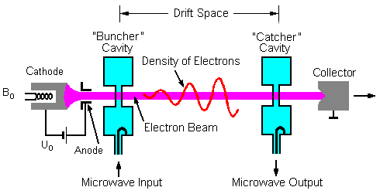
Sources of RF Power
For frequencies above ~300 MHz, the most common power source is the “klystron”, which is actually a little accelerator itself
Electrons are bunched and accelerated, then their kinetic energy is extracted as microwave power.

Slide 37
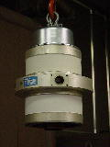
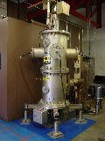
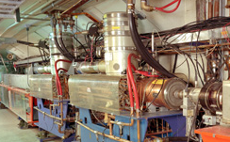
Sources of RF Power (cont’d)
For lower frequencies (<300 MHz), the only sources significant power are triode tubes, which haven’t changed much in decades.
53 MHz Power Amplifier for Booster RF cavity
FNAL linac 200 MHz Power Amplifier

